Slide 1
Peptide Computing – Universality and Complexity
M.Sakthi Balan
Kamala Krithivasan
Y.Sivasubramanyam
Department of Computer Science and Engineering,
Indian Institute of Technology, Madras, India

Slide 2
Organization
Natural Computing
Biological Computing
DNA Computing
Peptide Computing
Solving HPP
Solving Exact 3-cover set problem
Universality Result
Conclusion

Slide 3
Natural Computing
Biological Computing
Quantum Computing

Slide 4
Biological Computing
DNA Computing
Peptide Computing

Slide 5
DNA Computing
Uses DNA strands and Watson-Crick Complementarity as operation
Highly non-deterministic
Massive parallelism
Solves NP-Complete Problems quite efficiently

Slide 6
Peptide Computing
Uses peptides and antibodies
Operation – binding of antibodies to epitopes in peptides
Epitope – The site in peptide recognized by antibody
Highly non-deterministic
Massive parallelism

Slide 7
Peptide Computing
Contd..
Peptides – sequence of amino acids
Twenty amino acids. Example – Glycine, Valine
Connected by covalent bonds

Slide 8
Peptide Computing
Contd..
Antibodies recognizes epitopes by binding to it
Binding of antibodies to epitopes has associated power called affinity
Higher priority to the antibody with larger affinity power

Slide 9
Computing
DNA Vs Peptide
Four building blocks
Adenine (A), Guanine(G), Cytosine (C), Thiamine (T)
Only one reverse complement – Watson-Crick Complement
Complement (A) = T and Complement (G) = C
Twenty building blocks (20 amino acids)
Example: Glycine, Valine
Different antibodies can recognize different epitopes
Binding affinity of antibodies can be different

Slide 10
Peptide Computing Model
Peptides represent sample space of the problem
Antibodies are used to select the correct solution of the problem (i.e. peptides)

Slide 11
Definition
For finite sequence M = m₁,m₂,…,m_{n} the doubly duplicated sequence is
MM = m₁,m₁,m₂,m₂,…,m_{n},m_{n}
Doubly duplicated permutation of a finite set S is
{mm | m is a permutation of the set S}

Slide 12
Hamiltonian Path Problem
G = (V,E) is a directed graph
V = {v₁,v₂,…,v_{n}} is the vertex set
E = {e_{ij} | v_{i} is adjacent to v_{j}} is the edge set
v₁ - source vertex, v_{n} – end vertex
Problem – Test whether there exists a Hamiltonian path between v₁ and v_{n}

Slide 13

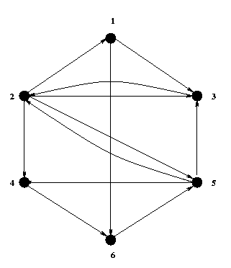
Graph G

Slide 14
Peptides Formation
Each vertex v_{i} has a corresponding epitope ep_{i}
Each peptide has ep₁ on one extreme and ep_{n} on the other extreme
All doubly duplicated permutations of
{ep₂, … ,ep_{n-1}} are formed in each of the peptide in between ep₁ and ep_{n}

Slide 15
Antibody Formation
Form antibodies A_{ij} – site = ep_{i}ep_{j} s.t. v_{j} is adj. to v_{i}
Form antibodies B_{ij} – site = ep_{i}ep_{j} s.t. v_{j} is not adj. to v_{i}
Form antibody C – site is whole of peptide
Affinity(B_{ij}) > Affinity(C)
Affinity(C) > Affinity(A_{ij})

Slide 16
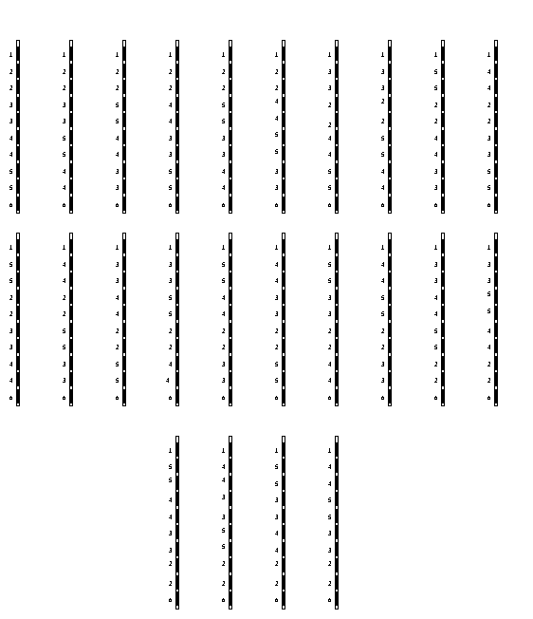
Peptide Solution Space

Slide 17
Algorithm
Take all the peptides in an aqueous solution
Add antibodies Aij
Add antibodies Bij
Add labeled antibody C
If fluorescence is detected answer is yes or else the answer is no

Slide 18
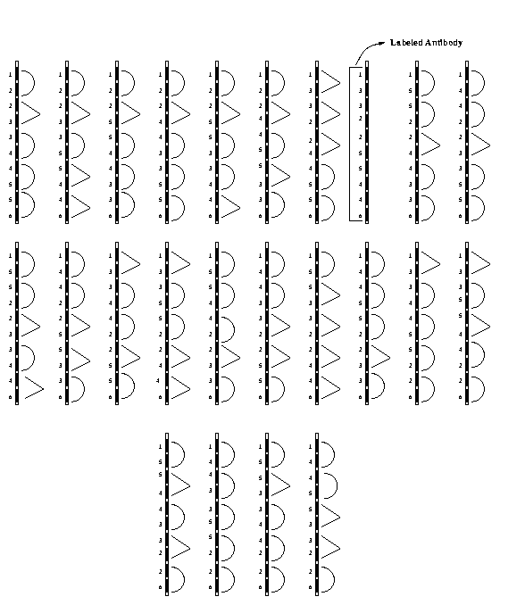
Peptides with Antibodies

Slide 19
Peptide with Antibodies

Slide 20
labeled antibody

Slide 21
Complexity
Number of peptides = (n-2)!
Length of peptides = O(n)
Number of antibodies = O(n²)
Number of Bio-steps is constant

Slide 22
Exact Cover by 3-Sets Problem
Instance: A finite set X = {x₁,x₂,…,x_{n}},
n = 3q and a collection C of 3-elements subsets of X
Question: Does C contain an Exact Cover for X

Slide 23
Peptide Formation
For each xi a specific epitope ep_{i} is chosen
For every permutation of the set {ep_{i}} a peptide is chosen s.t. every subsequence of ep_{i} ep_{j} ep_{k} is followed by the epitope ep_{ijk}

Slide 24
Example
X = {x₁,x₂,…,x₉}
For permutation
x₁, x₇, x₉, x₂, x₆, x₄ , x₃, x₅, x₈

Slide 25
Antibody Formation
Form antibodies A_{ijk}, site = ep_{i} ep_{j} ep_{k} if
{x_{i},x_{j},x_{k}} is in C
Form antibodies B_{ijk}, site = ep_{i} ep_{j} ep_{k} if
{x_{i},x_{j},x_{k}} is not in C
Form colored antibody C, site is whole of peptide
Affinity(B_{ijk}) > Affinity(C)
Affinity(C) > Affinity(A_{ijk})

Slide 26
Algorithm
Take all the antibodies in an aqueous solution.
Add antibodies Aijk
Add antibodies Bijk
Add antibody C
If fluorescence is detected the answer is yes otherwise no

Slide 27
Complexity
Number of peptides = n!
Length of peptides = O(n)
Number of Antibodies = O(n³)
Number of Bio-steps is constant

Slide 28
Peptide Computing is Computationally Complete
A Turing Machine can be
simulated by a Peptide System

Slide 29
Assumptions
Turing Machine halts when it reaches a final state
Let s(n) be the space complexity of the Turing Machine
Assume that s(n) is apriori known

Slide 30
Universality Result
Turing machine, M = (Q, Σ, δ, s₀, F)
Q = {q₁,q₂, … ,q_{m}}
Σ = {a₁,a₂, …,a_{l}}
B is the blank symbol

Slide 31
Universality Result
Contd..
Form s(n) epitopes,
E_{Q} = {ep_{i}^{Q} | 1 < i < s(n)}
Form s(n) epitopes,
E_{Σ} = {ep_{i}^{Σ}| 1 < i < s(n)}

Slide 32
Universality Result
Contd..
Form s(n)*m antibodies,
A_{Q} = {A_{i}^{q} | 1 < i < s(n), q Є Q}
Form s(n)*l antibodies,
A_{Σ} = {A_{i}ª | 1 < i < s(n), a Є Σ U {b}}
The antibodies A_{i}^{q}_{f} are labeled

Slide 33
Universality Result
Contd..
Peptide without antibodies

Slide 34
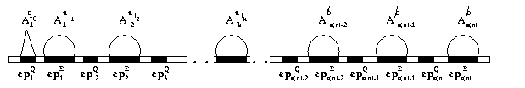
Initial Configuration of Peptide

Slide 35
Simulating the Right Move
M moves from a_{i} q a_{j} a_{j’} to a_{i} a_{j’’} q’ a_{j’}
Add excess of free epitopes ep_{k}^{Σ} and ep_{k}^{Q}
Add antibodies A_{k}ª_{j’’} and A_{k+1}^{q’}
k is the position of the head prior to the right move

Slide 36
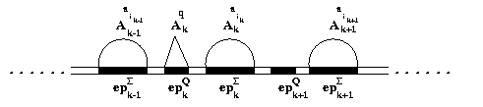
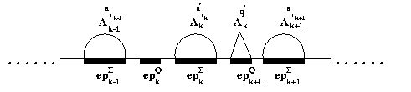
Simulating the Right Move
Contd..

Slide 37
Simulating the Left Move
M moves from a_{i} q a_{j} a_{j’} to q’a_{i} a_{j’’} a_{j’}
Add excess of free epitopes ep_{k}^{Σ} and ep_{k}^{Q}
Add antibodies A_{k}ª_{j’’} and A_{k-1}^{q’}
k is the position of the head prior to the right move

Slide 38
Complexity
Peptide system takes O(t(n)) time
Length of the peptide is O(s(n))
Number of peptide is one
Amount of antibodies is
O(m.s(n)+l.(s(n))

Slide 39
What Next…
Complexity Issues
Cost effectiveness
Implementation Difficulties
Theoretical Model

Slide 40
Thank You

